Slide 1
Capstone Project
- Ruchi Giradkar
Notes:
Good afternoon, my name is Ruchi Giradkar, and I will be presenting my Capstone Project. This project focuses on vulnerability assessment, penetration testing, and forensic analysis to highlight real-world cybersecurity challenges and solutions.

Slide 2
Agenda
01 | Project Problem Statement
02 | Approach
03 | Outcome
04 | Opportunities for Improvement
05 | Conclusion
Notes:
Here is the agenda for my presentation. I will start by explaining the problem statement that the project addresses. Then I will walk you through the approach I used, the outcomes I achieved, and highlight some opportunities for improvement. Finally, I will wrap up with the conclusion. Before diving into the project details, let me briefly introduce my background and professional experience, which provided the foundation for this work.

Slide 3

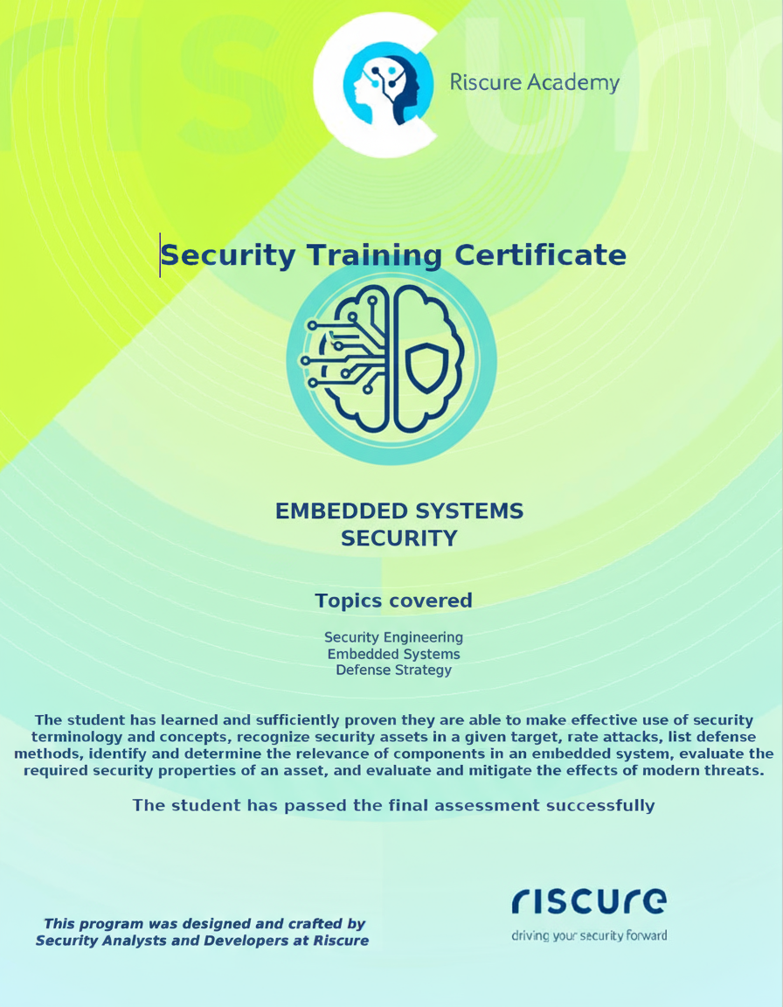
Professional Summary
About Me
Cybersecurity Specialist with 3+ years of experience in risk assessment, vulnerability analysis, and security architecture.
Industry experience at Continental Automotive, applying ISO/SAE 21434 and TARA methodology to secure automotive systems.
Masters Degree in Mechatronic and Cyber-Physical Systems from Deggendorf Institute of Technology, Germany (2021).
Master thesis at Bosch, developing a Digital Twin based Intrusion Detection System for Industry 4.0 connected sensors.
Software development background with 3 years of experience at NTT DATA and Fujitsu in India.
B.Eng. in Electronics and Telecommunication, Cummins College of Engineering for Women
Certifications
CompTIA Security+
Embedded System Security
Goal
Applying cybersecurity skills across industries to make systems more secure and resilient.
Notes:
I was working as a Cybersecurity Specialist with over three years of experience in risk assessment, vulnerability analysis, and security architecture.
At Continental Automotive, I worked with ISO/SAE 21434 and TARA methodology to secure automotive systems. I hold a Masters Degree in Mechatronic and Cyber-Physical Systems from Deggendorf Institute of Technology, where my thesis at Bosch focused on a digital twin–based intrusion detection system.
Earlier, I gained a strong software development foundation with NTT DATA and Fujitsu in India.
I am also certified in CompTIA Security+ and Embedded Systems Security.
My goal is to apply my cybersecurity skills across industries to make enterprise and industrial systems more secure and resilient.

Slide 4




Project Problem Statement
Context
TechShield facing client-reported security incidents
Weaknesses in network, web apps & passwords
Problem
Need for comprehensive VAPT
Include forensic analysis for evidence & attacker methods
Requirements
Vulnerability Assessment (Nmap, Greenbone)
Web & Password Testing (SQLi, Hydra)
Forensic Analysis (Autopsy)
Final VAPT Report + Presentation
Notes:
Now starting with the Project Problem Statement
In this project, TechShield was facing client-reported security incidents, exposing weaknesses in their network, web apps, and password security.
They needed more than a basic check — a full Vulnerability Assessment and Penetration Test, along with forensic analysis to understand attacker methods and collect evidence.
The requirements were clear: run vulnerability scans with Nmap and Greenbone, test web apps and passwords with Hydra, perform forensic analysis using Autopsy, and finally deliver a complete VAPT report with findings.

Slide 5
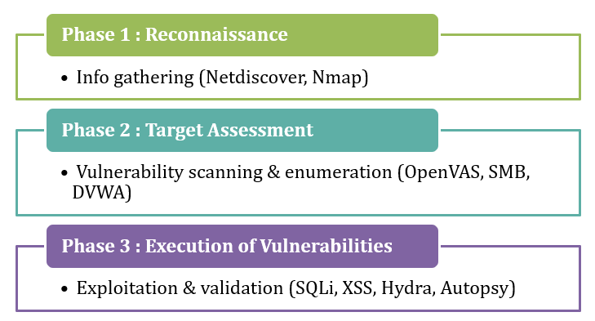
Approach: 3 Phases – Testing Module
Notes:
Next is the Approach
Our testing was done in three phases.
In Phase 1, Reconnaissance, we gathered information using tools like Netdiscover and Nmap.
Phase 2, Target Assessment, we scanned for vulnerabilities and did enumeration with OpenVAS, SMB, and DVWA.
And in Phase 3, Execution of Vulnerabilities, we validated those issues through SQL injection, XSS, password testing with Hydra, and forensic validation using Autopsy.
This step-by-step approach helped us move from gathering data to confirming real risks.

Slide 6
Milestones Roadmap
Milestone 1
Forensic Analysis
Final VAPT Report
Milestone 5
Milestone 4
Milestone 2
Milestone 3
Network Vulnerability Assessment
Web Application Testing
Password Security Testing
Notes:
Next, we created the Milestone Roadmap
To keep the project structured, we broke it down into five milestones.
We started with Milestone 1: Network Vulnerability Assessment, where we scanned and identified weaknesses in the network.
Then in Milestone 2: Web Application Testing, we focused on checking for vulnerabilities like SQL injection and XSS in the applications.
Moving to Milestone 3: Password Security Testing, we tested the strength of authentication and password mechanisms.
In Milestone 4: Forensic Analysis, we used forensic tools to trace attacker activities and collect evidence.
Finally, in Milestone 5, we compiled everything into a complete VAPT report and presentation of the findings.
This roadmap helped us progress in a systematic way — step by step from scanning to final reporting.

Slide 7
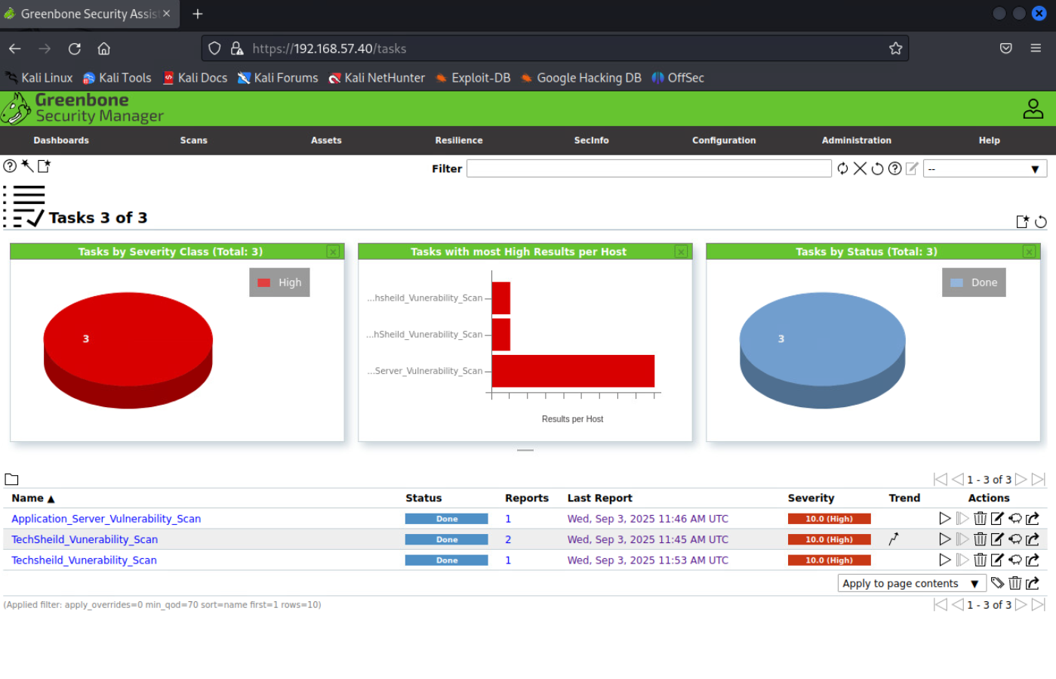
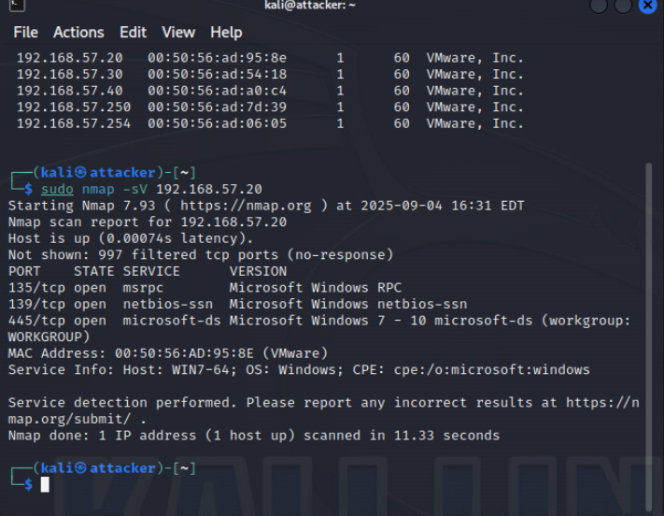
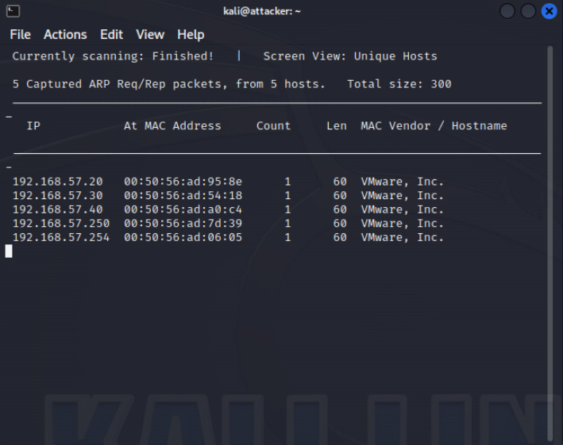
Approach – Milestone 1: Network Vulnerability Assessment
Tools/Platform:
Netdiscover, Nmap, Greenbone (OpenVAS)
Tasks:
Identify live hosts (Netdiscover)
Enumerate services & OS (Nmap)
Scan for vulnerabilities (Greenbone/OpenVAS)
Outcome:
Detected outdated OS (Windows 7)
Multiple SMB vulnerabilities (MS17-010 family)
Risk of remote code execution and privilege escalation
Netdiscover host discovery list (Victim-Laptop & Application Server)
Nmap scan output showing open ports (SMB, RDP, HTTP)
Greenbone report snippet with severity scores (High CVSS values)
Notes:
For the first milestone, our focus was on network vulnerability assessment.
We used tools like Netdiscover to identify live hosts in the network, and Nmap to enumerate operating systems and running services. After that, we scanned for vulnerabilities using Greenbone.
From this assessment, we found some critical issues. One of the hosts was running an outdated operating system, Windows 7, which is no longer supported. We also identified multiple SMB vulnerabilities, including MS17-010, which is the same family exploited by WannaCry.
These weaknesses indicated a serious risk of remote code execution and privilege escalation.
So this phase gave us a clear view of the network’s weak points and where attackers could get in.

Slide 8
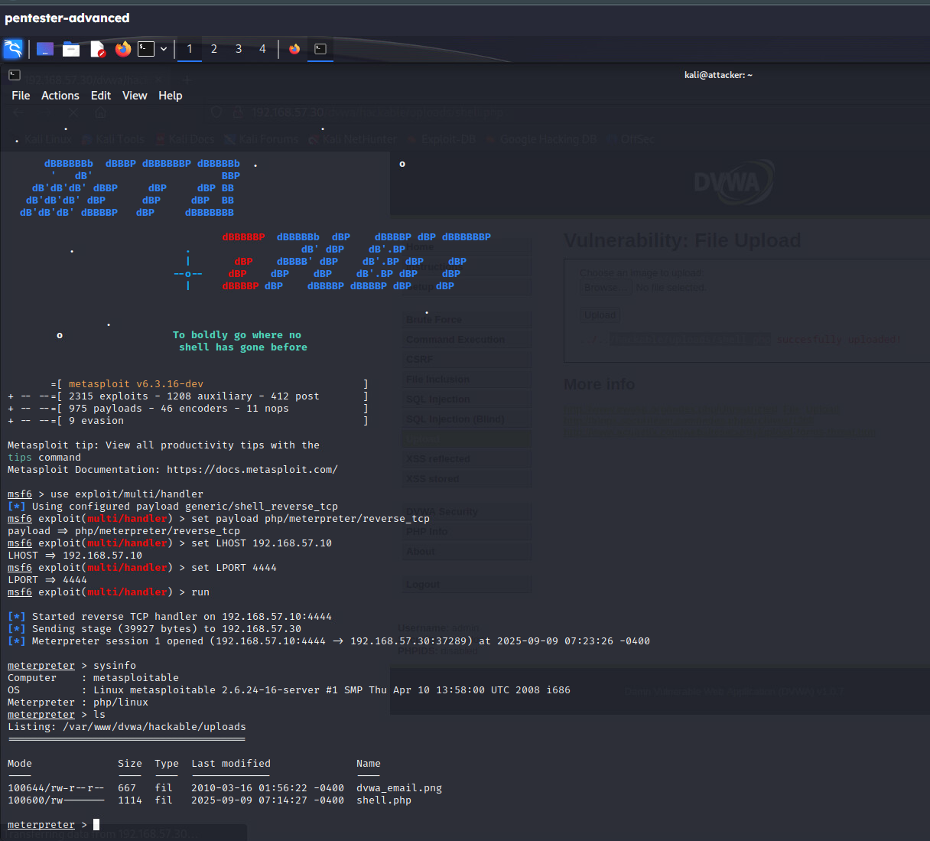

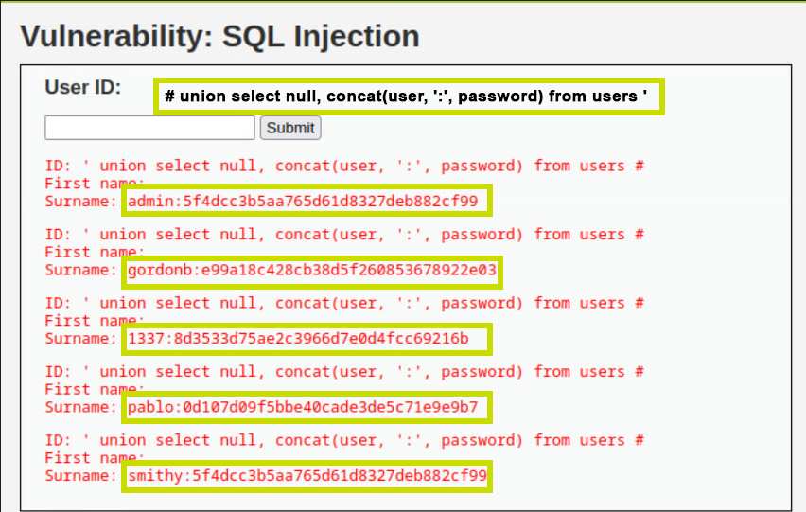
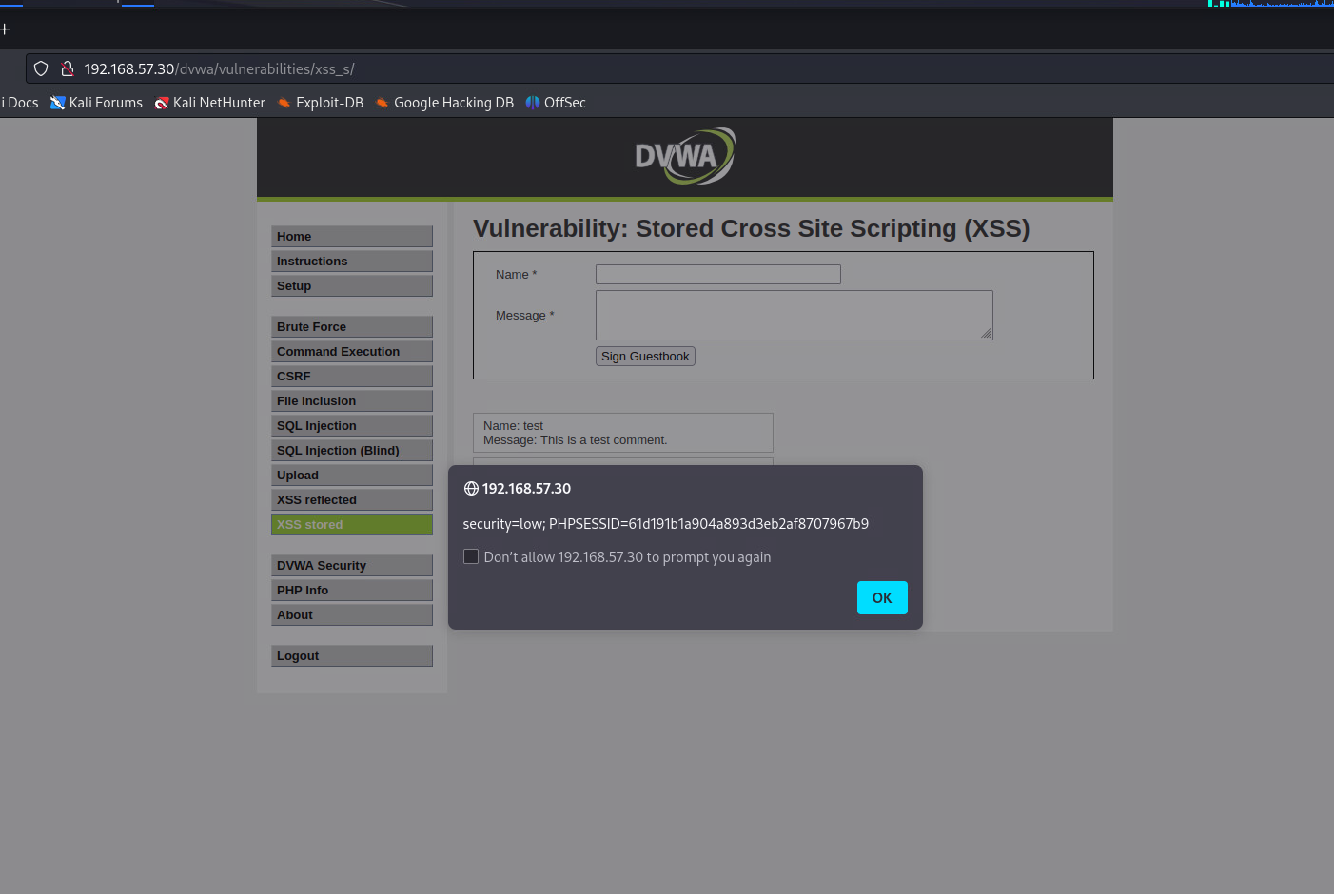
Approach – Milestone 2 (Web Application Security Testing)
Platform:
DVWA (Damn Vulnerable Web Application)
Tasks:
SQL Injection - Extracted database schema & credentials
Stored XSS - Stole session cookies
File Upload exploit - Uploaded PHP web shell
Reverse shell - Gained Meterpreter access
Outcome:
Proved data theft, session hijacking, and remote execution risks
Demonstrated attacker persistence via reverse shell
XSS alert box showing stolen cookie
Meterpreter session with sysinfo output
File upload success + command execution (whoami)
SQLi payload & extracted credentials (dvwa.users table)
Notes:
In the second milestone, we focused on web application testing using the DVWA platform.
We tested for common vulnerabilities:
With SQL injection, we were able to extract the database schema and even user credentials.
Using stored cross-site scripting, we stole session cookies, which could let an attacker hijack a user’s session.
With a file upload exploit, we uploaded a PHP web shell and executed commands on the server.
Finally, we used a reverse shell, which gave us Meterpreter access and persistent control.
The outcome clearly showed how serious these risks can be. We proved the potential for data theft, session hijacking, and remote command execution, and also demonstrated how attackers could maintain persistence in the system.
This phase highlighted the critical need for stronger web application defences.

Slide 9
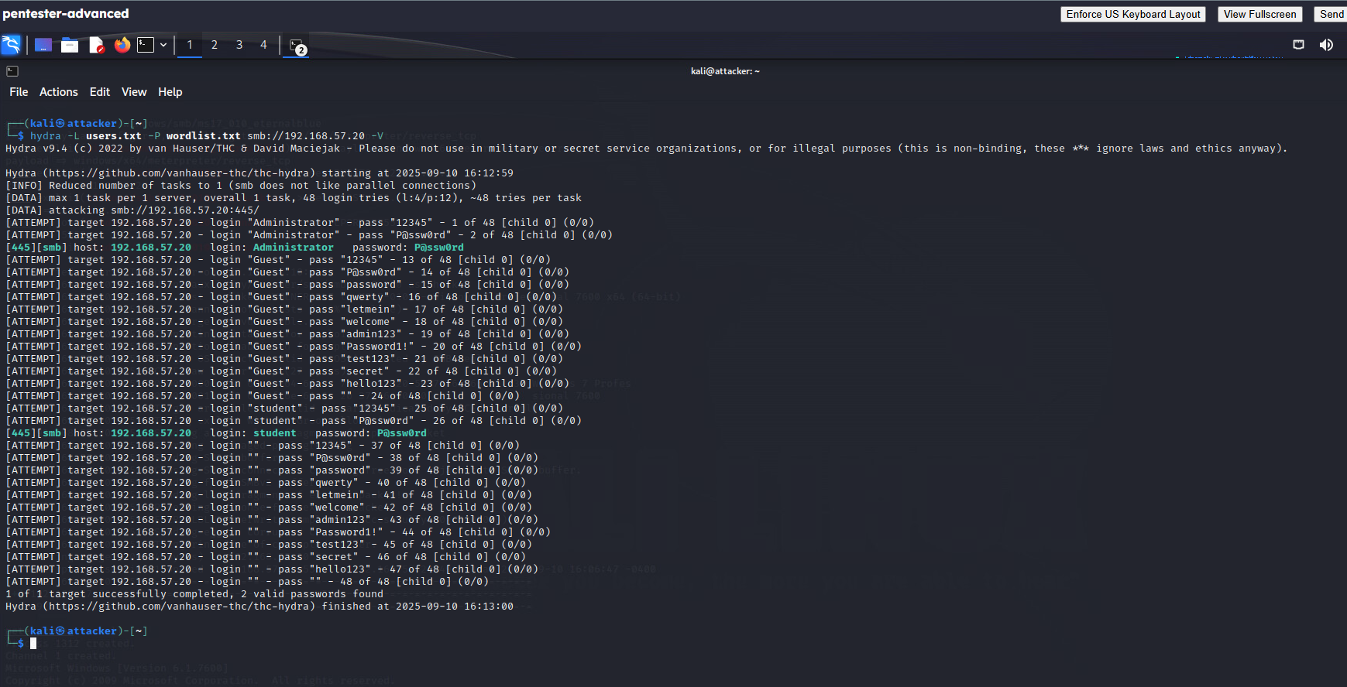
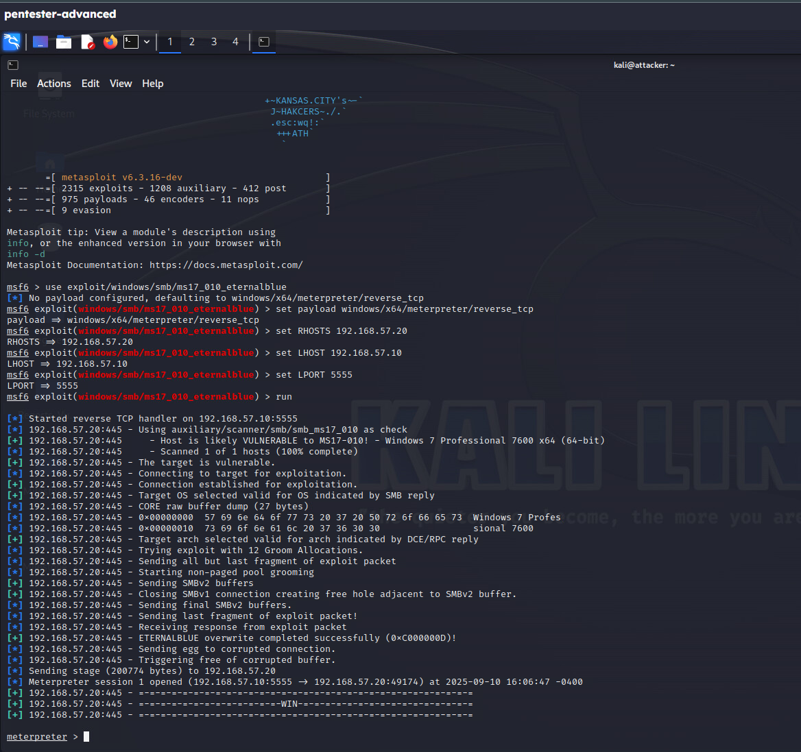
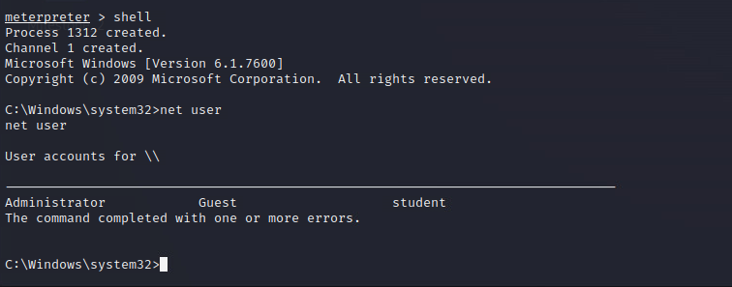
Approach – Milestone 3 (Password Security Testing)
Tools:
Metasploit (EternalBlue), Hydra
Tasks:
Exploit SMB vulnerability with EternalBlue
Enumerate user accounts (net user)
Create custom wordlist
Crack weak credentials with Hydra
Outcome:
Administrator : P@ssw0rd cracked
student : P@ssw0rd cracked
Privilege escalation to full system access
net user command showing account list
Hydra cracking result with valid credentials
EternalBlue exploit console (Metasploit)
Notes:
In the third milestone, we focused on password security testing.
We used Metasploit with the EternalBlue exploit to take advantage of an SMB vulnerability
and then enumerated the available user accounts.
After that, we created a custom wordlist and used Hydra to attempt password cracking.
The results were quite concerning — both the Administrator and student accounts had the same weak password, P@ssw0rd, which we were able to crack. This gave us the ability to escalate privileges and eventually gain full system access.
This clearly showed how weak credentials can open the door to complete compromise of a system.

Slide 10
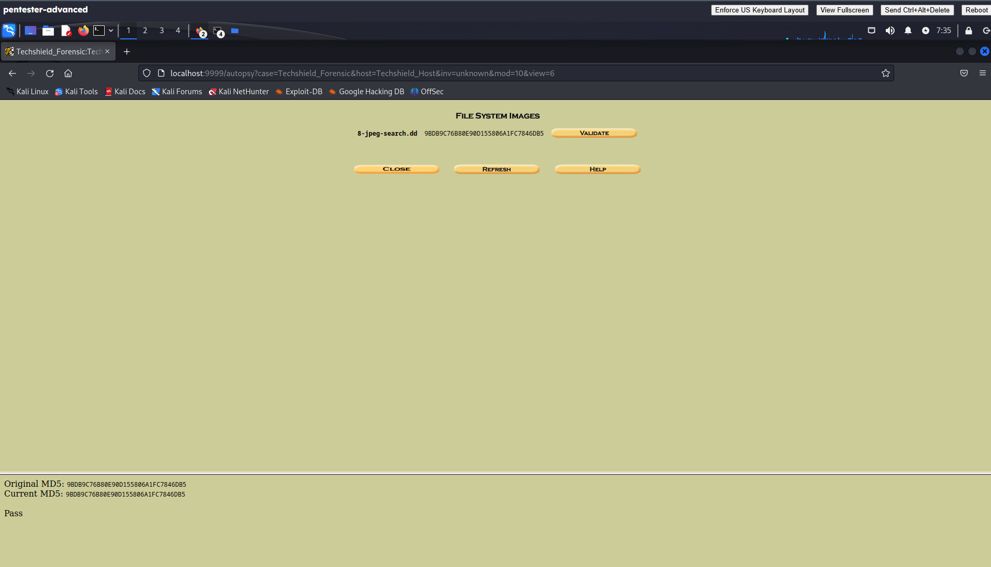
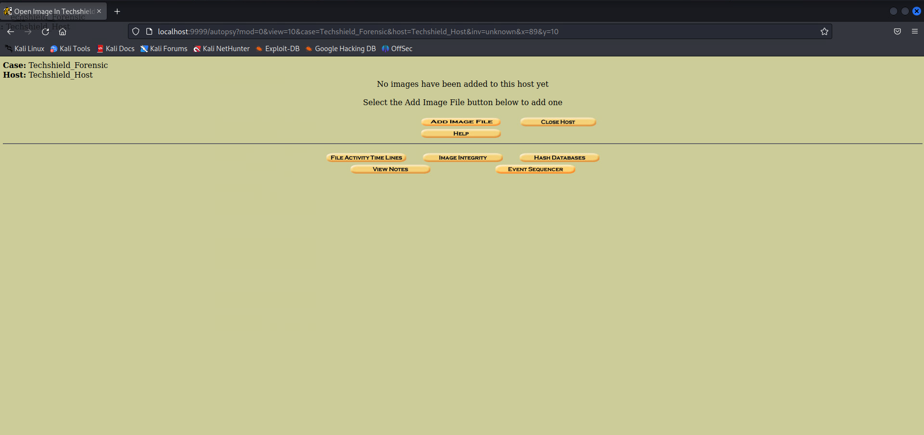
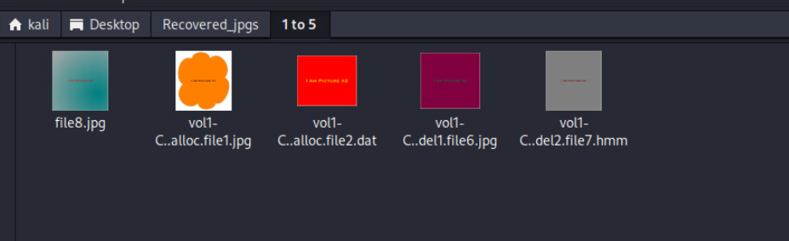
Approach – Milestone 4: Forensic Evidence Collection
Tools:
Autopsy, md5sum
Tasks:
Verified forensic image integrity (MD5 hash)
Imported image into Autopsy
Searched and recovered hidden JPG files
Documented suspicious/mislabeled files (file3.jpg, file4.jpg)
Outcome:
Chain of custody preserved (hash verified)
5 hidden images recovered
Evidence of obfuscation/steganography attempts
Search results showing hidden files (file1.jpg, file6.jpg, file7.jpg, imapicture2, file8.zip)
md5sum hash output
Autopsy case setup screen
Notes:
In this forth milestone, our goal was to collect and analyze digital evidence.
We started by verifying the forensic image integrity using MD5 hash values to make sure the data wasn’t altered. Then, we imported the image into Autopsy, where we searched for hidden files.
During the analysis, we recovered several hidden JPG files and also found suspicious or mislabeled files, such as file3.jpg and file4.jpg.
The outcome was clear:
The chain of custody was preserved since the hash was verified.
We recovered five hidden images.
And we found signs of obfuscation and possible steganography attempts, which attackers often use to hide data.
This step helped demonstrate how forensic tools can uncover hidden evidence while maintaining proper investigation standards.

Slide 11
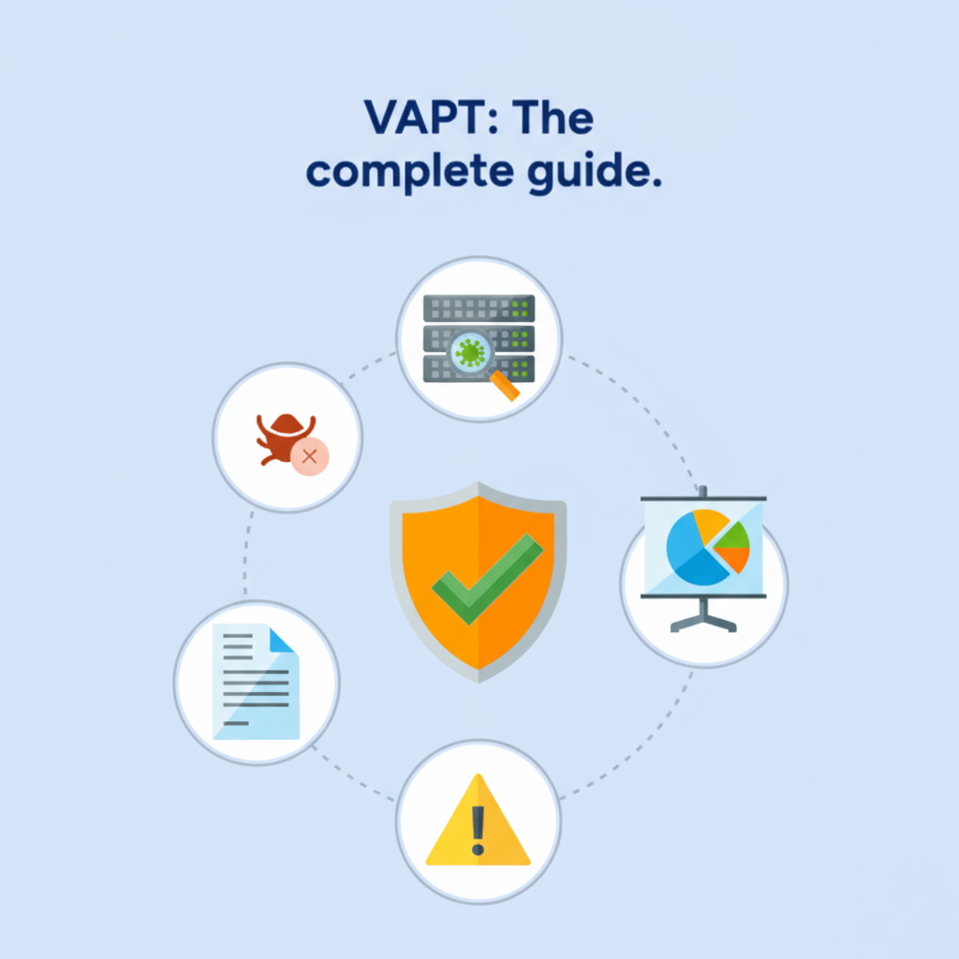
Project Outcomes – Overview
Deliverables:
Comprehensive VAPT Report
Forensic Analysis Report (with evidence recovery)
Final Capstone Presentation Deck
Summary of Outcomes:
58 vulnerabilities identified (16 High, 38 Medium, 4 Low)
Weak passwords and outdated systems confirmed as critical risks
Web application flaws successfully exploited, proving data theft and remote control was possible
Forensic artifacts recovered, maintaining chain of custody
Notes:
Now discussing about the Project Outcome
At the end of the project, we delivered three key outputs: a detailed VAPT report, a forensic analysis report with recovered evidence, and this final presentation deck.
In total, we identified 58 vulnerabilities, including 16 high-severity issues. Critical risks included weak passwords and outdated systems.
We also demonstrated how web application flaws could lead to data theft and remote control and recovered forensic artifacts while maintaining the chain of custody.
Overall, the project highlighted serious risks and provided clear evidence for remediation.

Slide 12

Outcome – Milestone 1 (Network Assessment)
Findings:
Outdated Windows OS (End-of-Life)
Multiple SMB vulnerabilities (MS17-010 family)
Exposed RPC and timestamp services
Interpretation:
Systems are highly exposed to remote code execution and lateral movement
Legacy software poses long-term risks
Recommendations:
Patch and migrate unsupported systems
Disable SMBv1 and enforce SMB signing
Restrict unnecessary services (RPC, timestamps)
Notes:
The Outcome of Milestone 1 is:
In the network assessment, we found an outdated Windows OS running with multiple SMB vulnerabilities, including MS17-010, and exposed services like RPC.
This meant the systems were highly exposed to remote code execution and lateral movement, with legacy software adding long-term risks.
Our recommendation was to patch or migrate unsupported systems, disable SMBv1 with stronger SMB controls, and restrict unnecessary services.

Slide 13

Outcome – Milestone 2 (Web App Security)
Findings:
SQL Injection - Database enumeration & credential leakage
Stored XSS - Session hijacking risk
File Upload Exploit - Remote command execution
Reverse Shell - Persistent attacker access
Interpretation:
Application is highly vulnerable to OWASP Top 10 attacks
Attackers could steal sensitive data or gain system control
Recommendations:
Implement input validation & parameterized queries
Enforce file upload restrictions
Apply Content Security Policy (CSP) & HttpOnly cookies
Deploy Web Application Firewall (WAF)
Notes:
The Outcome of Milestone 2 is:
In the web application assessment, we found serious issues including SQL injection, cross-site scripting, file upload exploits, and even a reverse shell — giving persistent attacker access.
This means the application is highly vulnerable to OWASP Top 10 attacks, putting sensitive data and system control at risk.
To fix this, we recommend stronger input validation, restricting file uploads, applying content security policies, and deploying a web application firewall.

Slide 14
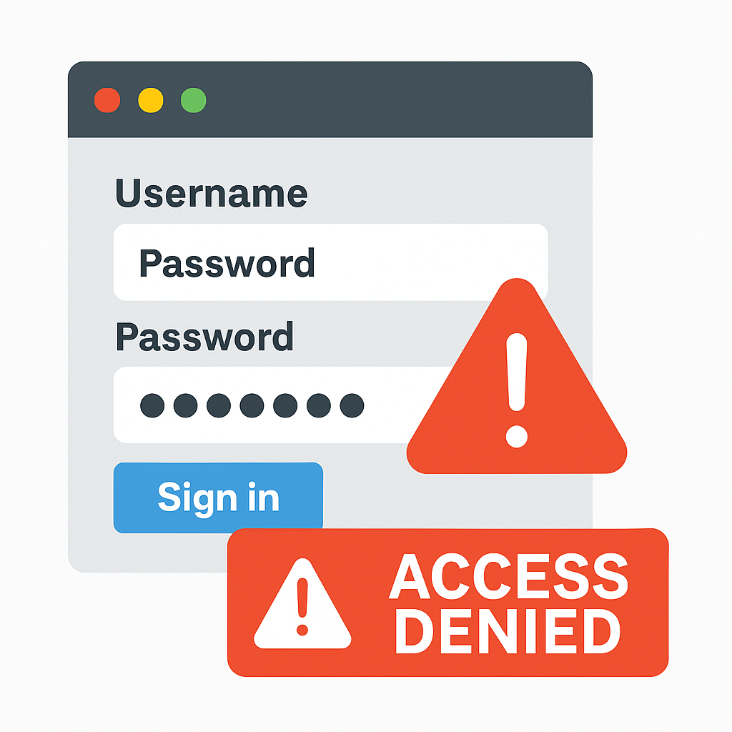
Outcome – Milestone 3 (Password Security)
Findings:
EternalBlue exploit successful
Weak credentials cracked: Administrator : P@ssw0rd, student : P@ssw0rd
Interpretation:
Critical accounts compromised → Privilege escalation risk
Brute force attacks succeed due to weak policies
Recommendations:
Enforce strong password policy (≥12 chars, complexity rules)
Enable account lockouts & MFA
Disable/rename default accounts
Centralized monitoring for brute-force attempts
Notes:
The Outcome of Milestone 3 is:
In the password security phase, we successfully ran the EternalBlue exploit and cracked weak credentials for both the Administrator and student accounts, all using P@ssw0rd.
This showed that critical accounts could be compromised, leading to privilege escalation, and brute-force attacks were effective due to weak password policies.
To fix this, we recommend enforcing stronger password rules, enabling MFA and account lockouts, disabling default accounts, and adding centralized monitoring.

Slide 15

Outcome – Milestone 4 (Forensic Evidence)
Findings:
MD5 hash verified (integrity maintained)
5 hidden images successfully recovered
Obfuscation attempts (mislabeling, corrupted files, steganography hints) detected
Interpretation:
Attackers used file mislabeling and concealment tactics
Forensic readiness confirmed with proper evidence handling
Recommendations:
Standardize forensic investigation procedures
Train staff in forensic tools (Autopsy)
Maintain readiness with incident response playbooks
Notes:
The Outcome of Milestone 4 is:
In the forensic phase, we verified the image integrity with MD5, recovered five hidden images, and detected obfuscation attempts like file mislabeling and steganography hints.
This confirmed attackers were trying to conceal evidence, but we maintained proper chain of custody.
Our recommendations include standardizing forensic procedures, training staff on tools like Autopsy, and keeping incident response playbooks ready

Slide 16

Opportunities for Improvement
Areas of Improvement in My Submission
Forensics Depth - Expand beyond hidden file recovery (e.g., metadata, steganography).
Collaboration - More team-based red vs blue simulations.
Continuous Learning - Try emerging tools like AI-driven anomaly detection.
If I Had to Do It Again
Begin report drafting in parallel with testing to reduce last-minute rush.
Integrate SIEM/monitoring to demonstrate real-time detection.
Use advanced cracking tools (Hashcat/JTR) for deeper password analysis.
Notes:
Now discussing about the Opportunities for Improvement
Looking back, there are a few areas I could improve.
First, going deeper in forensics beyond just hidden files, and adding more collaboration through red vs blue simulations. I had also like to keep learning and try newer tools like AI-driven anomaly detection.
If I had to do it again, I would start drafting reports in parallel with testing, integrate SIEM for real-time monitoring, and use stronger cracking tools like Hashcat for password analysis.

Slide 17
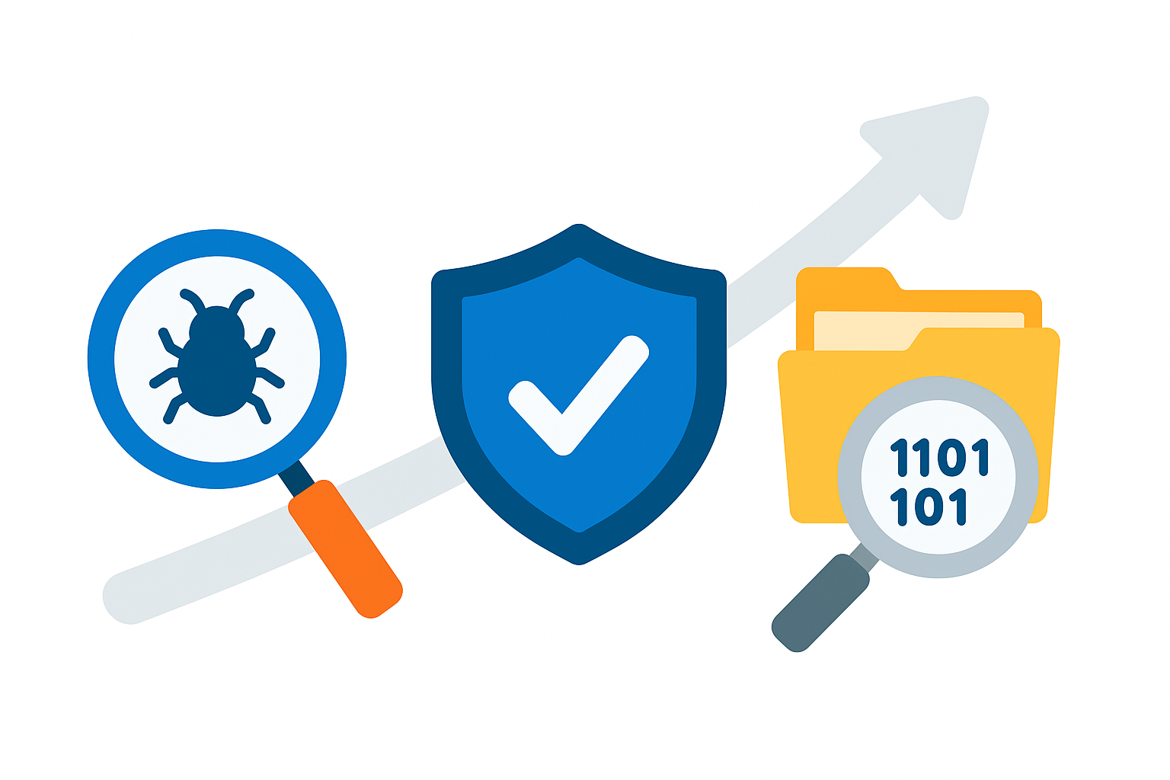
Conclusion
End-to-End Vulnerability Management Vulnerabilities must be identified, exploited ethically, and validated with forensics for credibility.
Foundational Security Practices Strong defences such as patching, secure coding, and robust password policies remain critical.
Forensic Readiness Ensures organizations can preserve evidence and respond effectively to incidents.
Notes:
To conclude, this project shows the importance of end-to-end vulnerability management — finding, testing, and validating issues with proper forensics.
It also reinforces the need for strong security practices like patching, secure coding, and robust passwords.
And finally, forensic readiness is key, so organizations can preserve evidence and respond effectively to incidents.
Thank you. I look forward to your questions and feedback.

Slide 18
Thank you!

